Slide 1
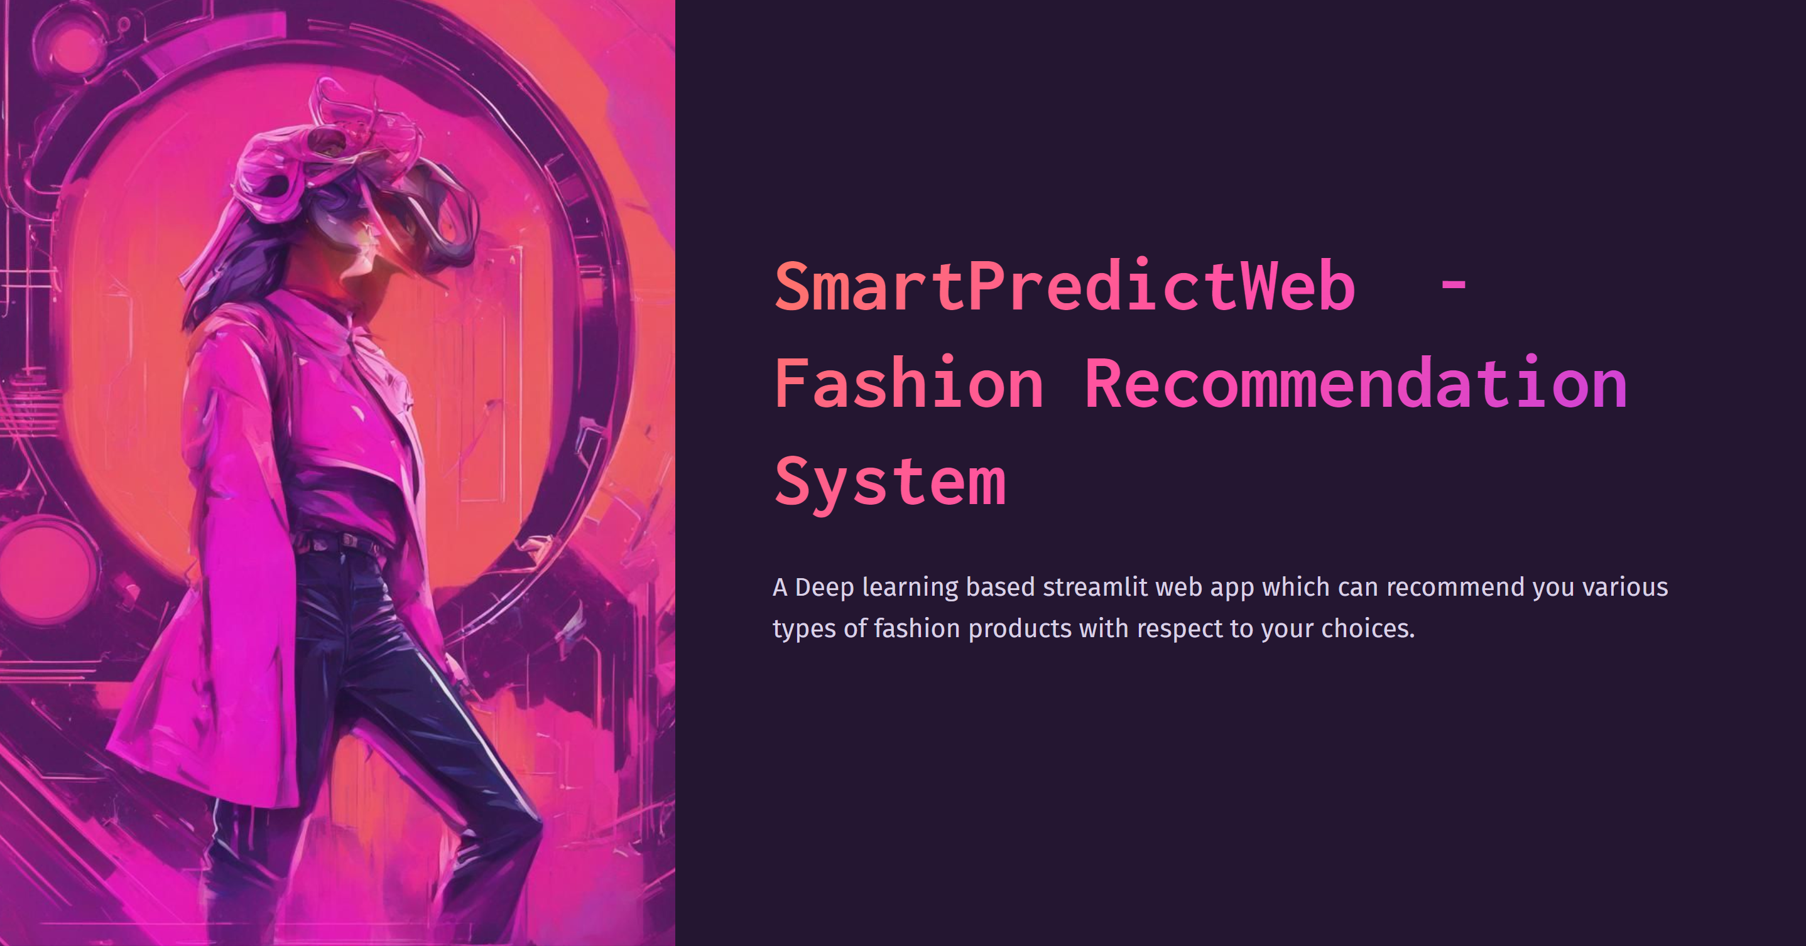

Slide 2

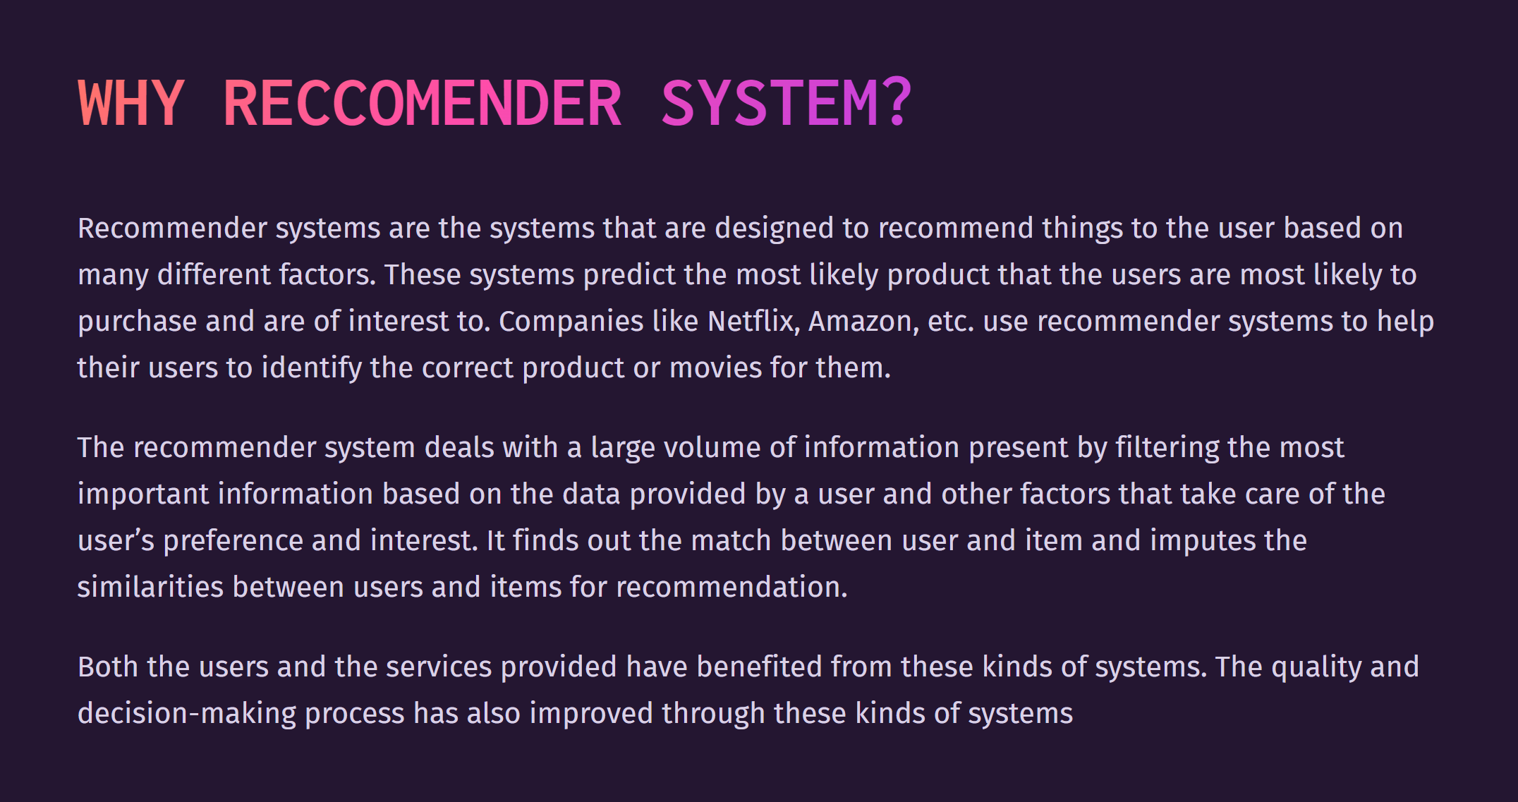

Slide 3
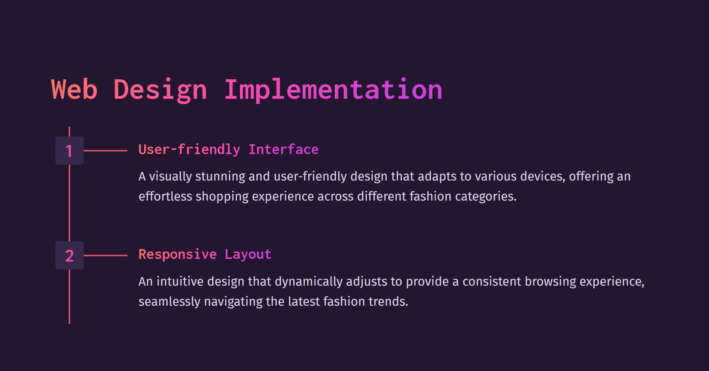
GitHub link : https://github.com/aashish1malik/fashion-recommendations-system-.git

Slide 4
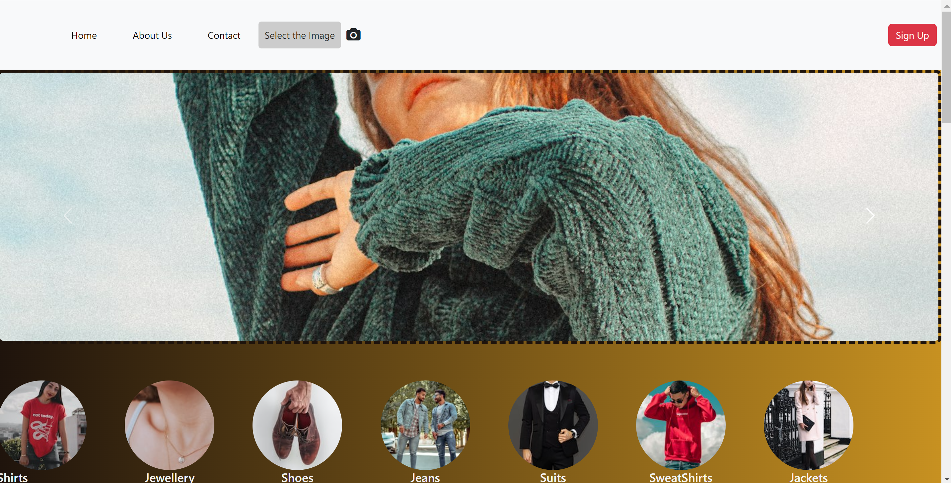
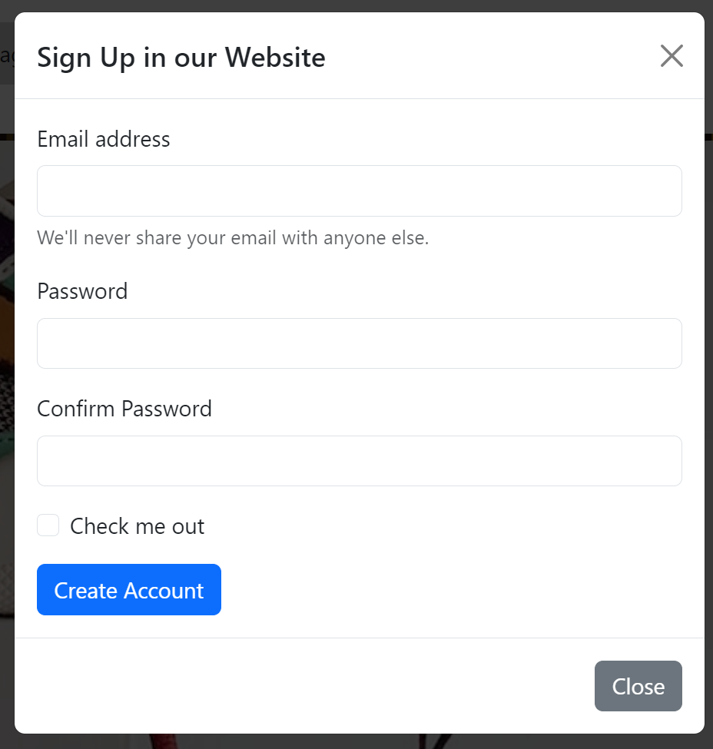
HOME PAGE!
🛍 How to Sign Up
Click on the "Sign Up" button.
Fill in your details – it's quick and easy!
Customize your profile to receive personalized recommendations.
Confirm your email to unlock member-only perks.
The sign-up page is a means of creating user accounts, allowing the website to uniquely identify and differentiate users.It provides a way for users to set up a personal profile with their information.
Personalization: With user accounts, websites can personalize the user experience. This includes tailoring content, recommendations, and settings based on individual preferences and behavior.

Slide 5
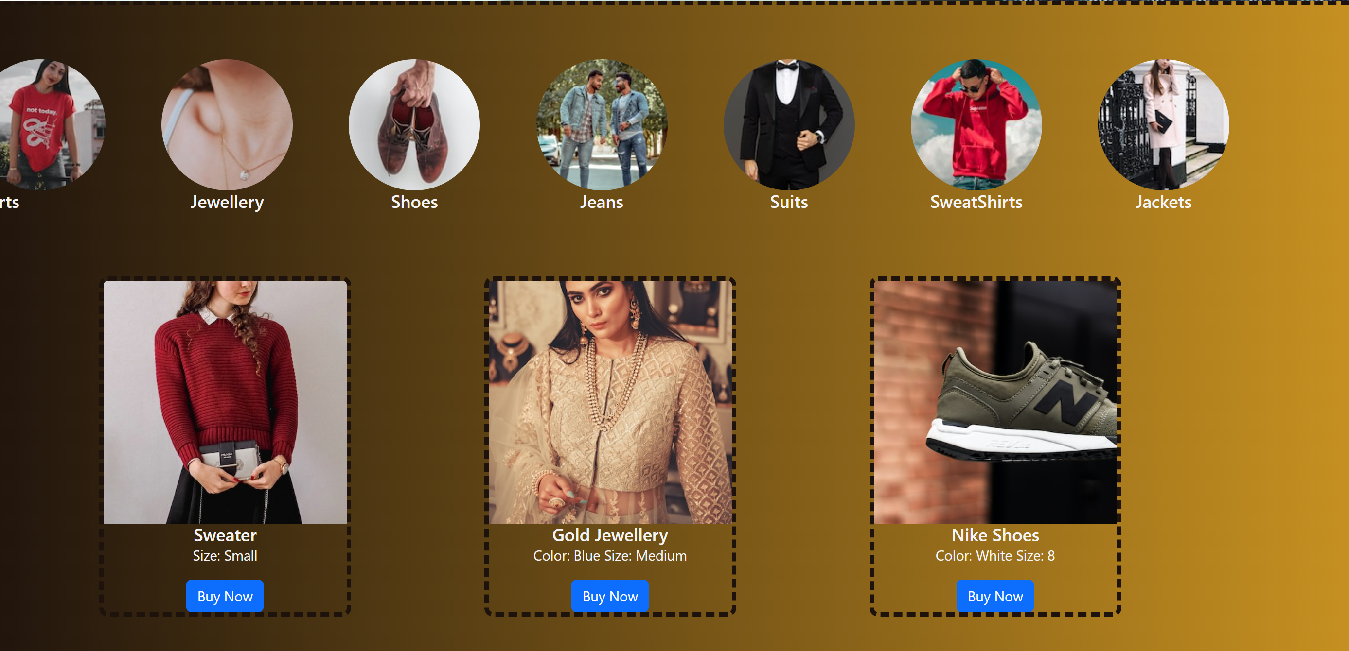
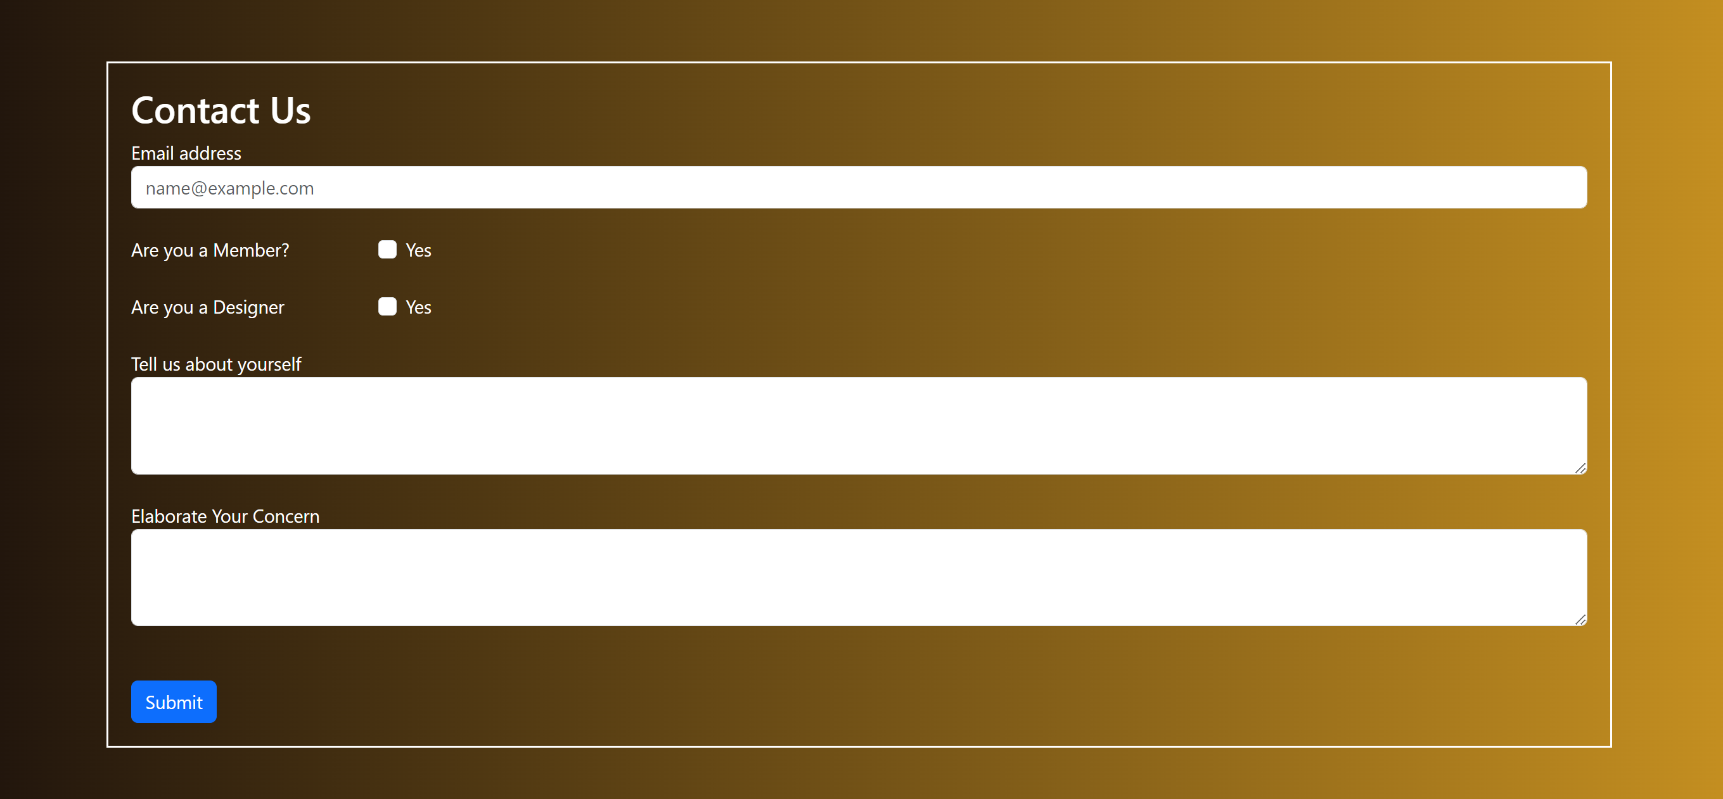
Visual Appeal: Cards allow for a visually appealing presentation of fashion items. Each card can showcase a specific product, outfit, or accessory, accompanied by high-quality images, making it visually engaging for users.
Bite-sized Information: Fashion websites often have a vast array of products. Cards provide a concise and structured way to present key information about each item, such as product name, price, and a brief description. This helps users quickly scan and identify products of interest.
User-Friendly Navigation: Cards facilitate a user-friendly browsing experience. Users can easily scroll through a collection of cards, making it intuitive to explore different fashion items without feeling overwhelmed by too much information at once.
The "Contact Us" page is an essential component of our website, designed to facilitate seamless communication and enhance your overall experience.
Whether you have inquiries about our products, need assistance with an order, or simply want to provide feedback, this dedicated space is where you can connect with us effortlessly.
Placed conveniently in our navigation menu, the "Contact Us" page is your gateway to prompt and personalized assistance.
We welcome your questions, value your feedback, and are committed to ensuring that your interactions with us are as smooth and satisfying as your experience with our products and services.

Slide 6
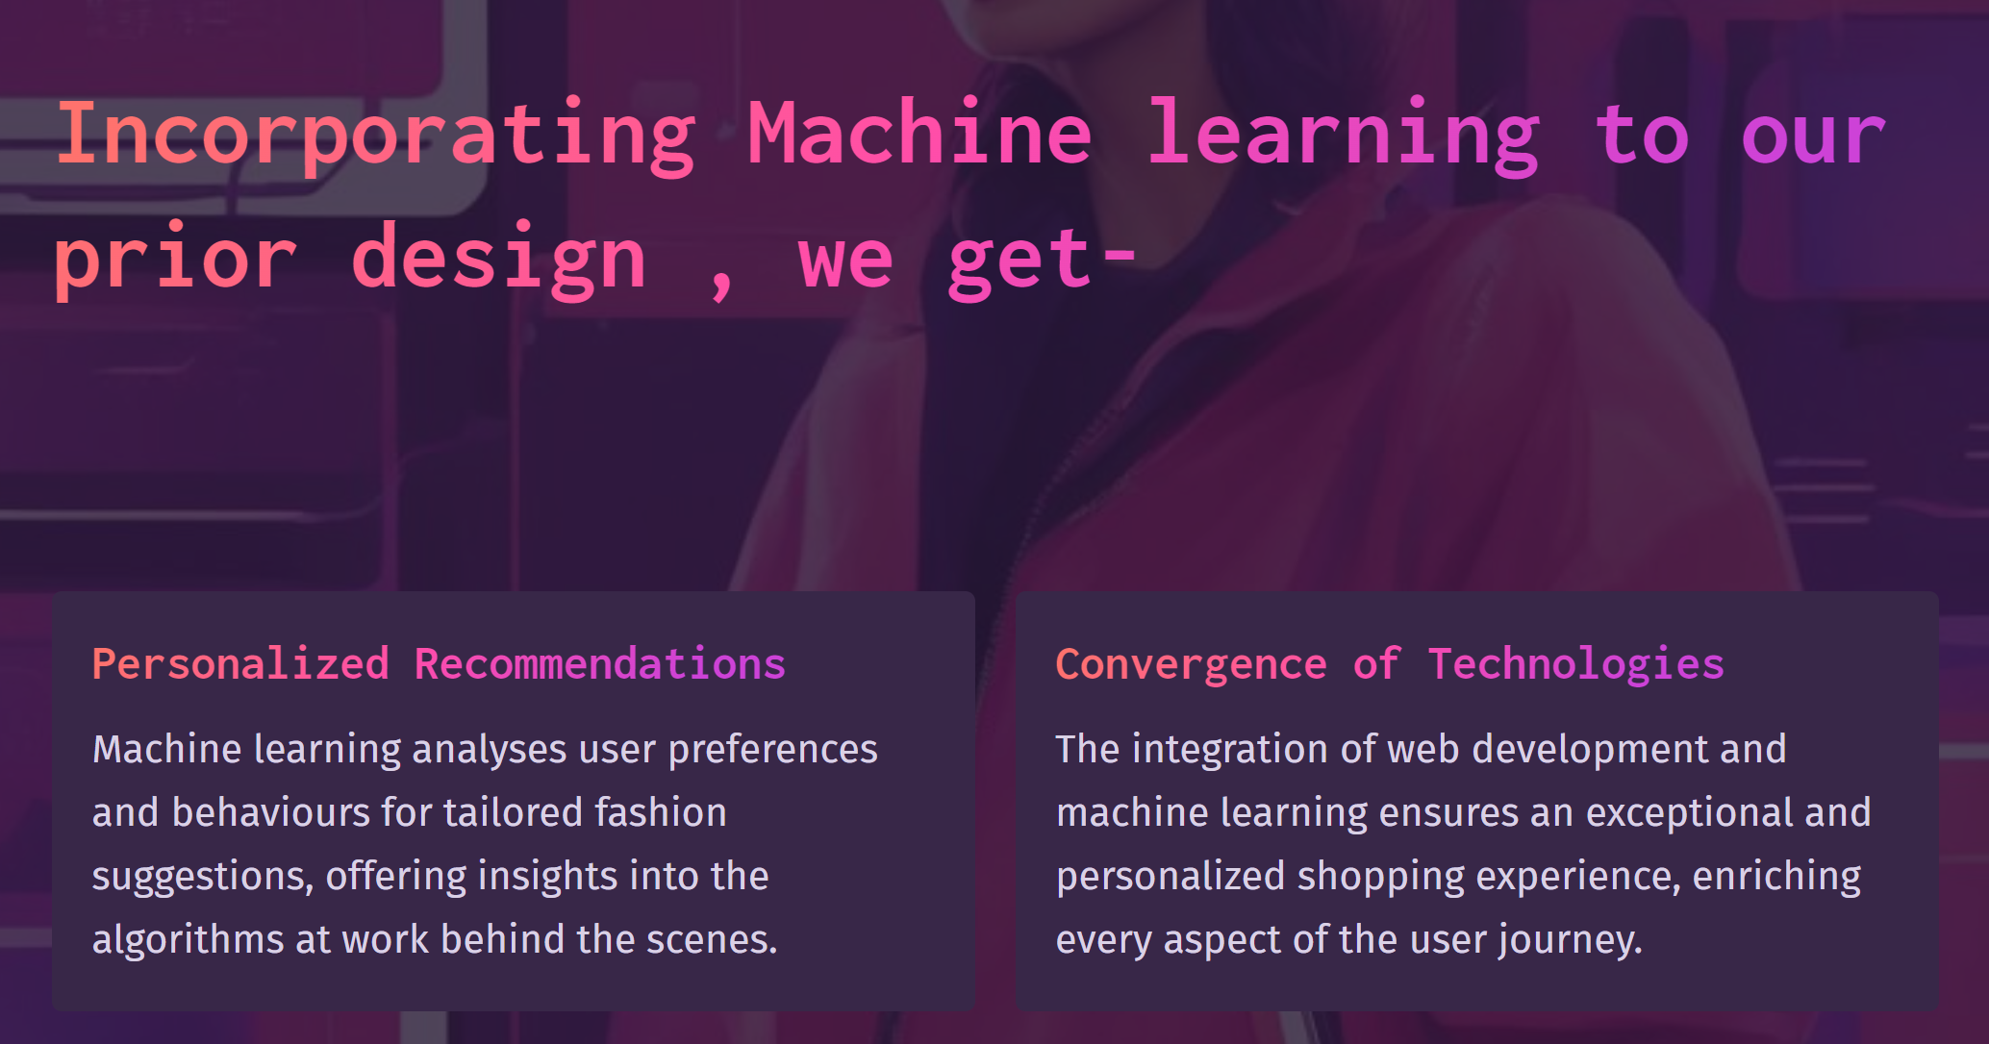

Slide 7
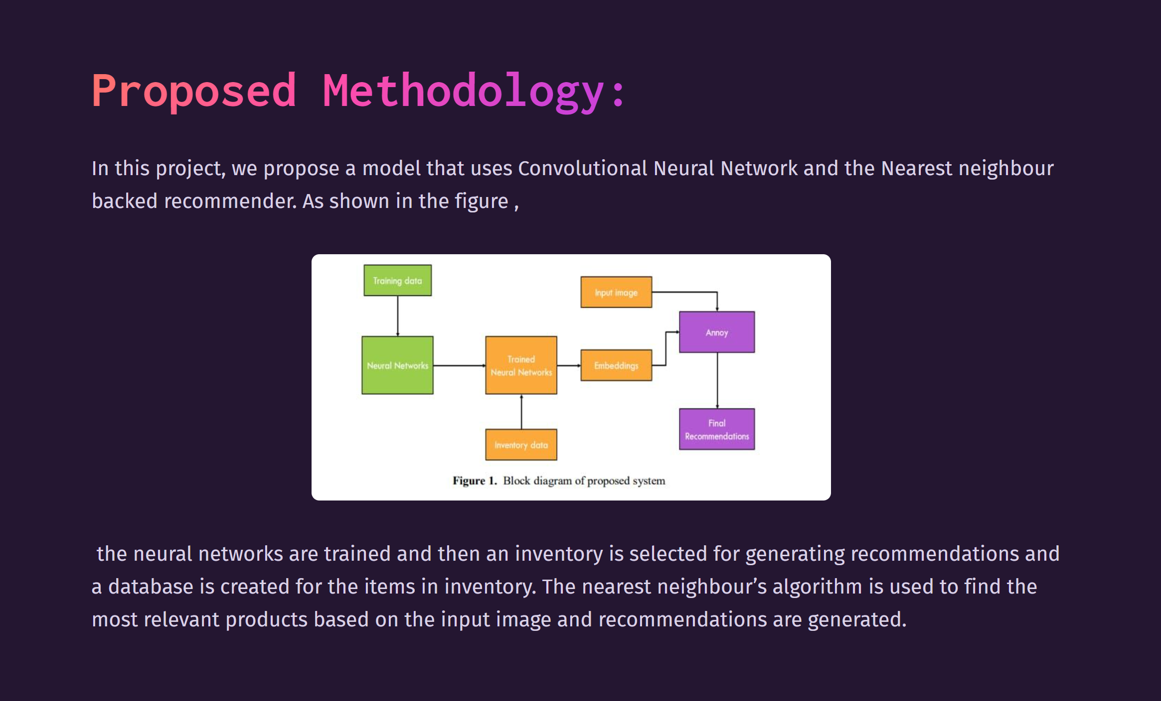

Slide 8
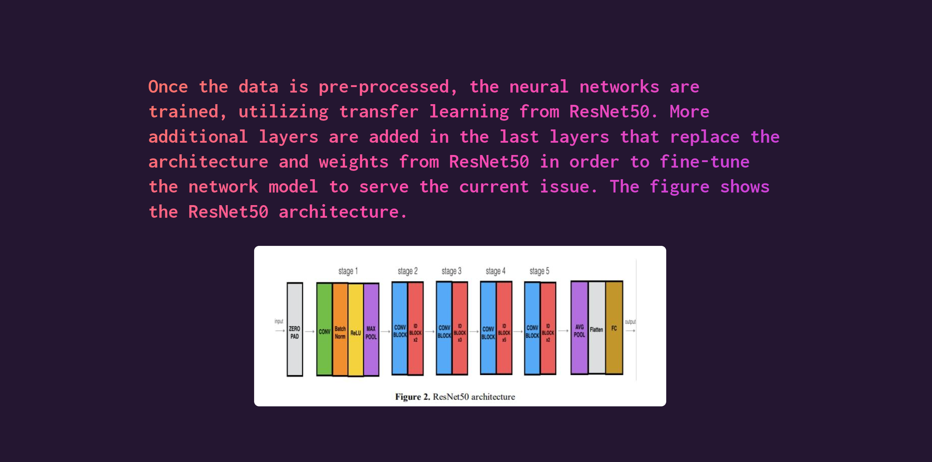

Slide 9


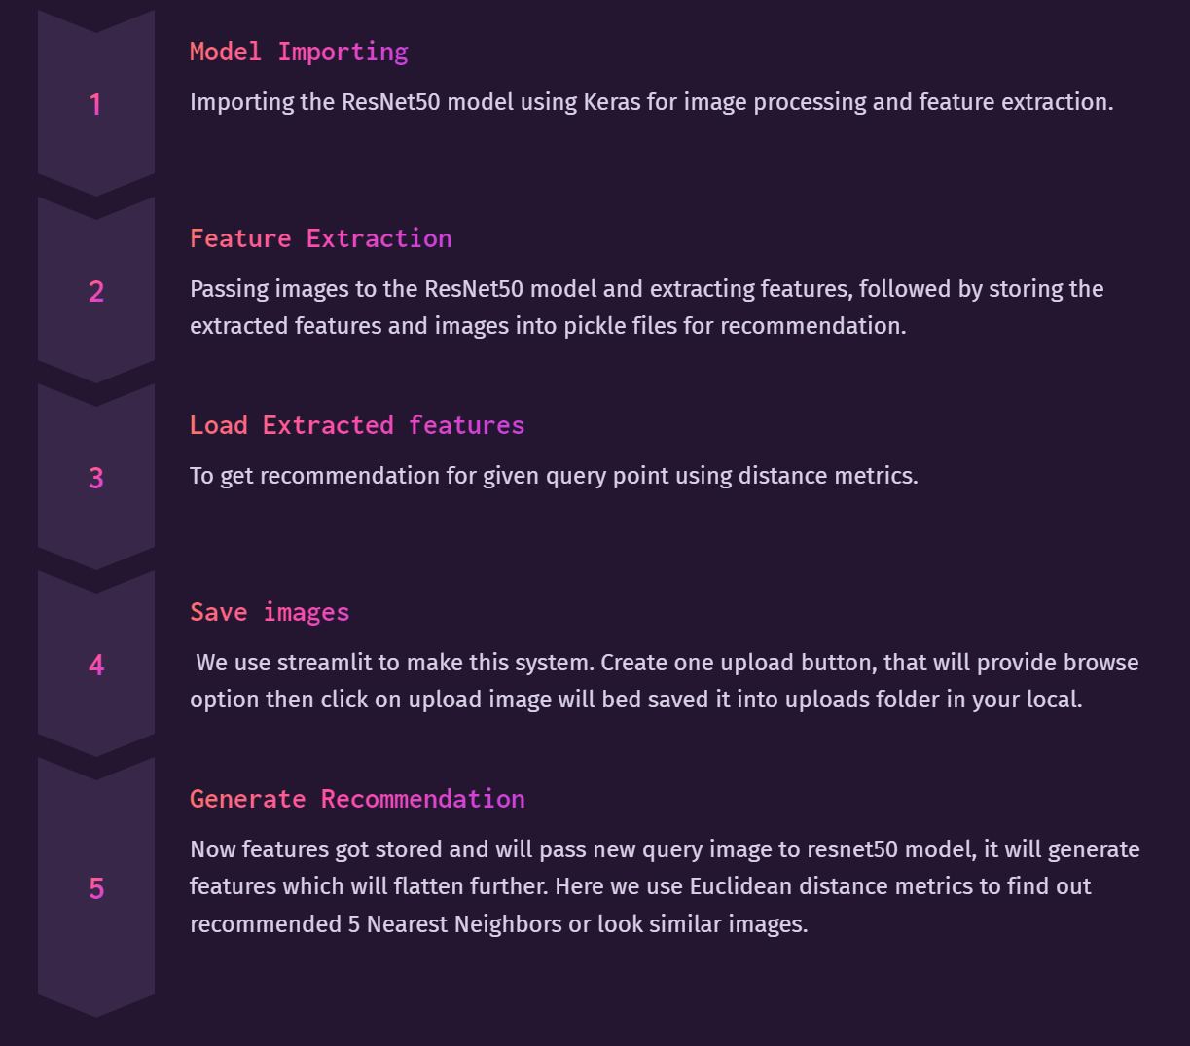

Slide 10
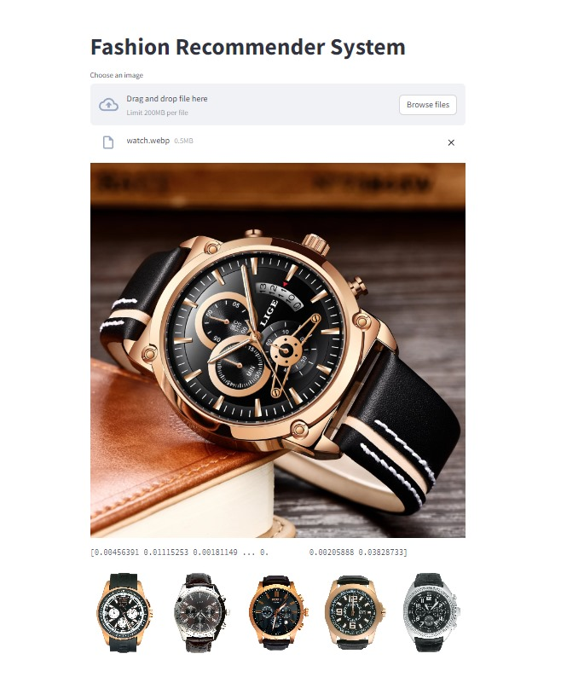
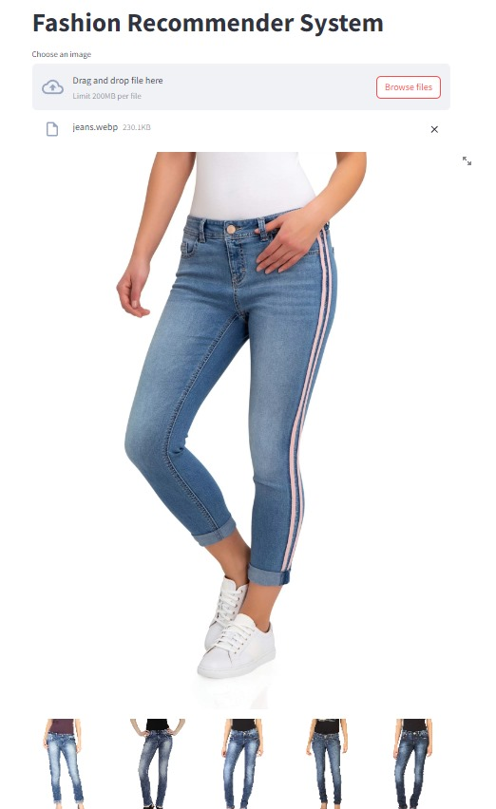
Benefits:
Enhanced Feature Learning:
ResNet's ability to capture intricate details aids in learning complex visual representations of fashion items.
Personalized Recommendations:
Regression modeling ensures that the recommendations are tailored to individual preferences, enhancing the user experience.
Adaptability to Diverse Styles:
The deep learning approach allows the model to adapt to a wide range of fashion styles and preferences present in the dataset.

Slide 11
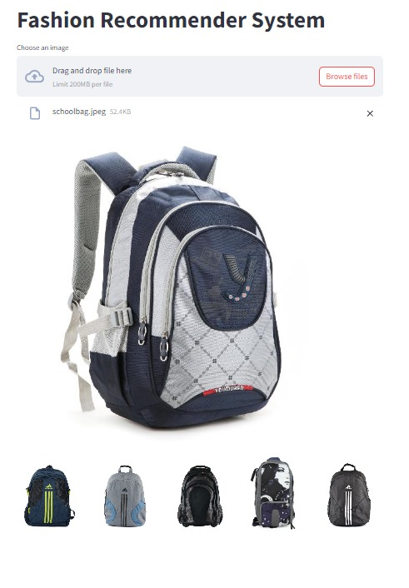
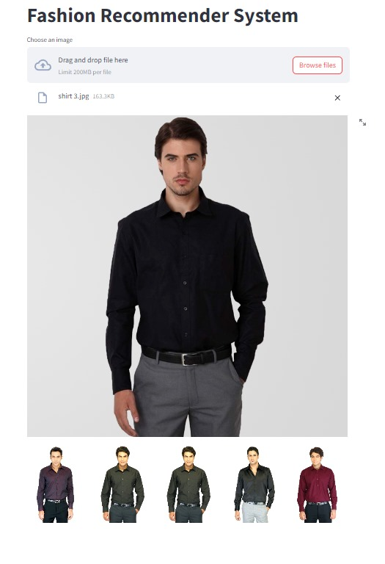
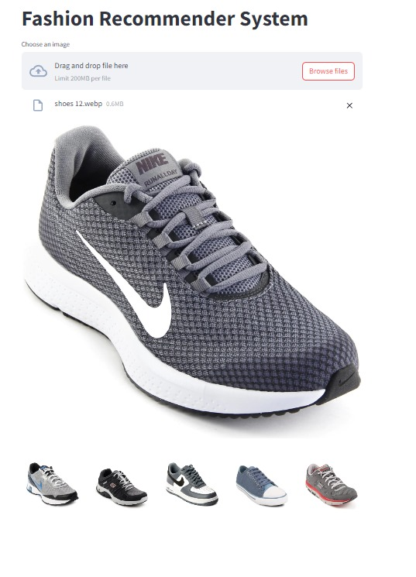
SOME MORE SAMPLE RESULTS!

Slide 12
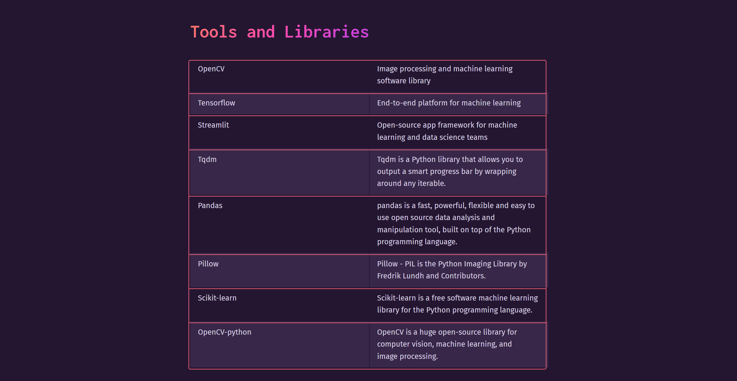

Slide 13
